Slide 1
Lecture 23: Fourier Transforms

Slide 2
Properties of Fourier Transforms
Conjugate symmetry
Linearity
Time shift
Modulation
Convolution
Duality
Parseval’s theorem
Integration
Differentiation

Slide 3
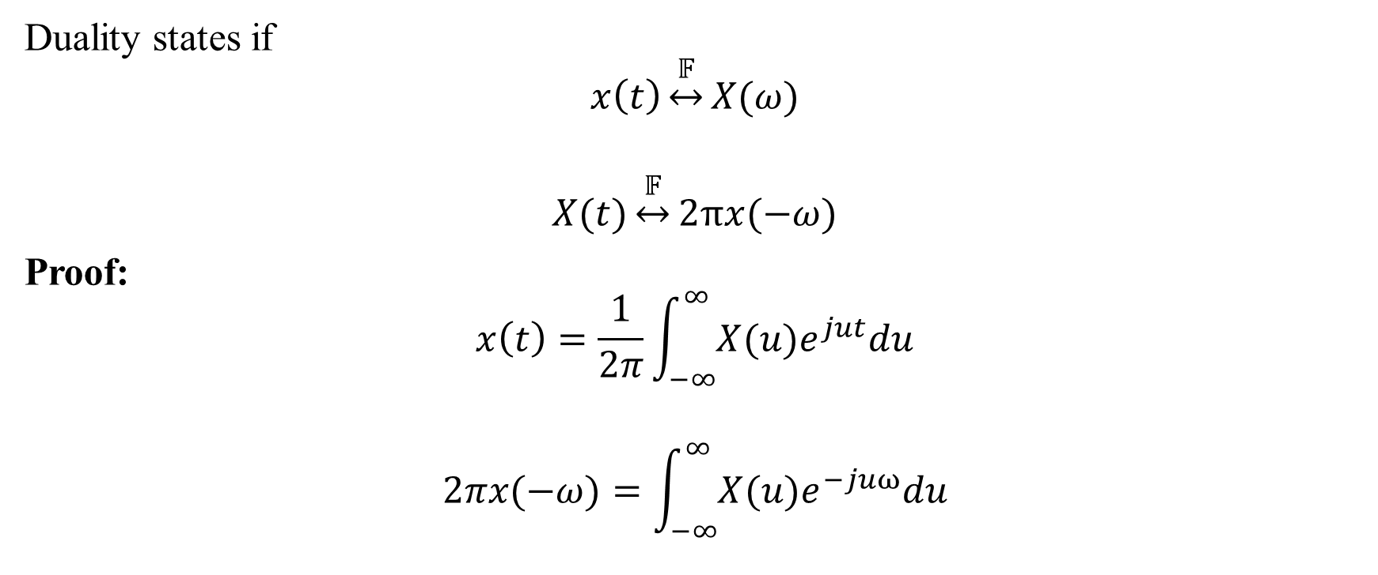
6. Duality
Duality states if
$$x\left(t\right)\underset{↔}{𝔽}X(ω)$$
$$X(t)\underset{↔}{𝔽}2πx(−ω)$$
Proof:
$$x\left(t\right)=\frac{1}{2π}\int_{−∞}^{∞}{X(u)e^{jut}du}$$
$$2πx(−ω)=\int_{−∞}^{∞}{X(u)e^{−juω}du}$$

Slide 4
6. Duality
Duality states if
$$x\left(t\right)\underset{↔}{𝔽}X(ω)$$
$$X(t)\underset{↔}{𝔽}2πx(−ω)$$
Proof:
$$x\left(t\right)=\frac{1}{2π}\int_{−∞}^{∞}{X(u)e^{jut}du}$$
$$2πx(−ω)=\int_{−∞}^{∞}{X(u)e^{−juω}du}$$
Prove using duality: $x\left(t\right)y(t)\underset{→}{F. T.}\frac{1}{2π}\left[X(ω)∗Y(ω)\right]$ (Multiplication property)

Slide 5
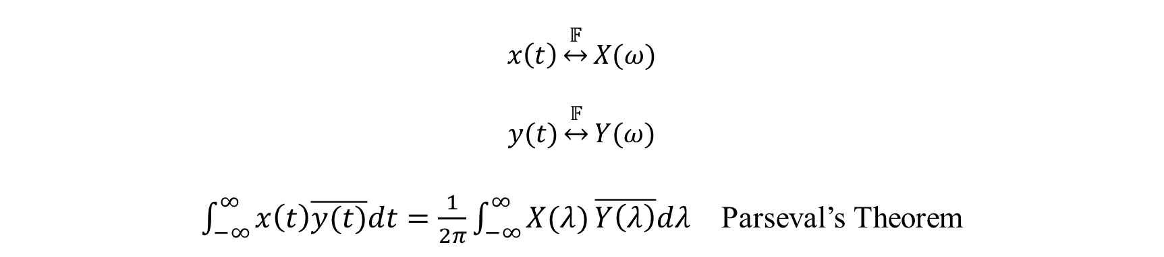
7. Parseval’s Theorem
$$x\left(t\right)\underset{↔}{𝔽}X(ω)$$
$$y(t)\underset{↔}{𝔽}Y(ω)$$
$\int_{−∞}^{∞}{x\left(t\right)\overline{y(t)}dt}=\frac{1}{2π}\int_{−∞}^{∞}{X(λ)}\overline{Y\left(λ\right)}dλ$ Parseval’s Theorem

Slide 6
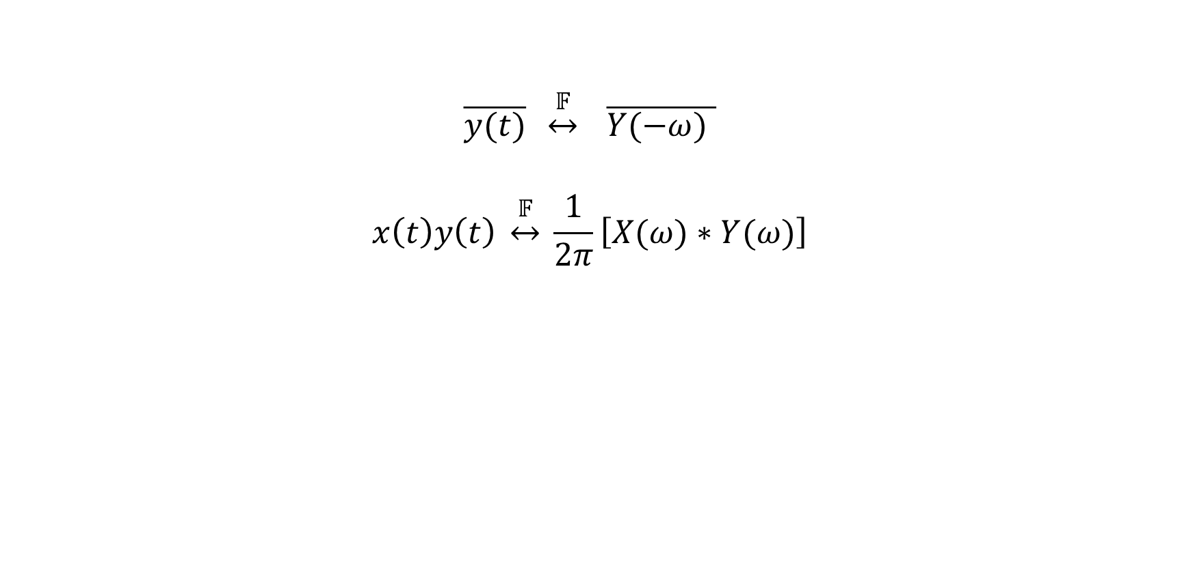
7. Parseval’s Theorem
$$\overline{y(t)} \underset{↔}{𝔽} \overline{Y(−ω) }$$
$$x\left(t\right)y\left(t\right) \underset{↔}{𝔽} \frac{1}{2π}\left[X(ω)∗Y(ω)\right]$$

Slide 7
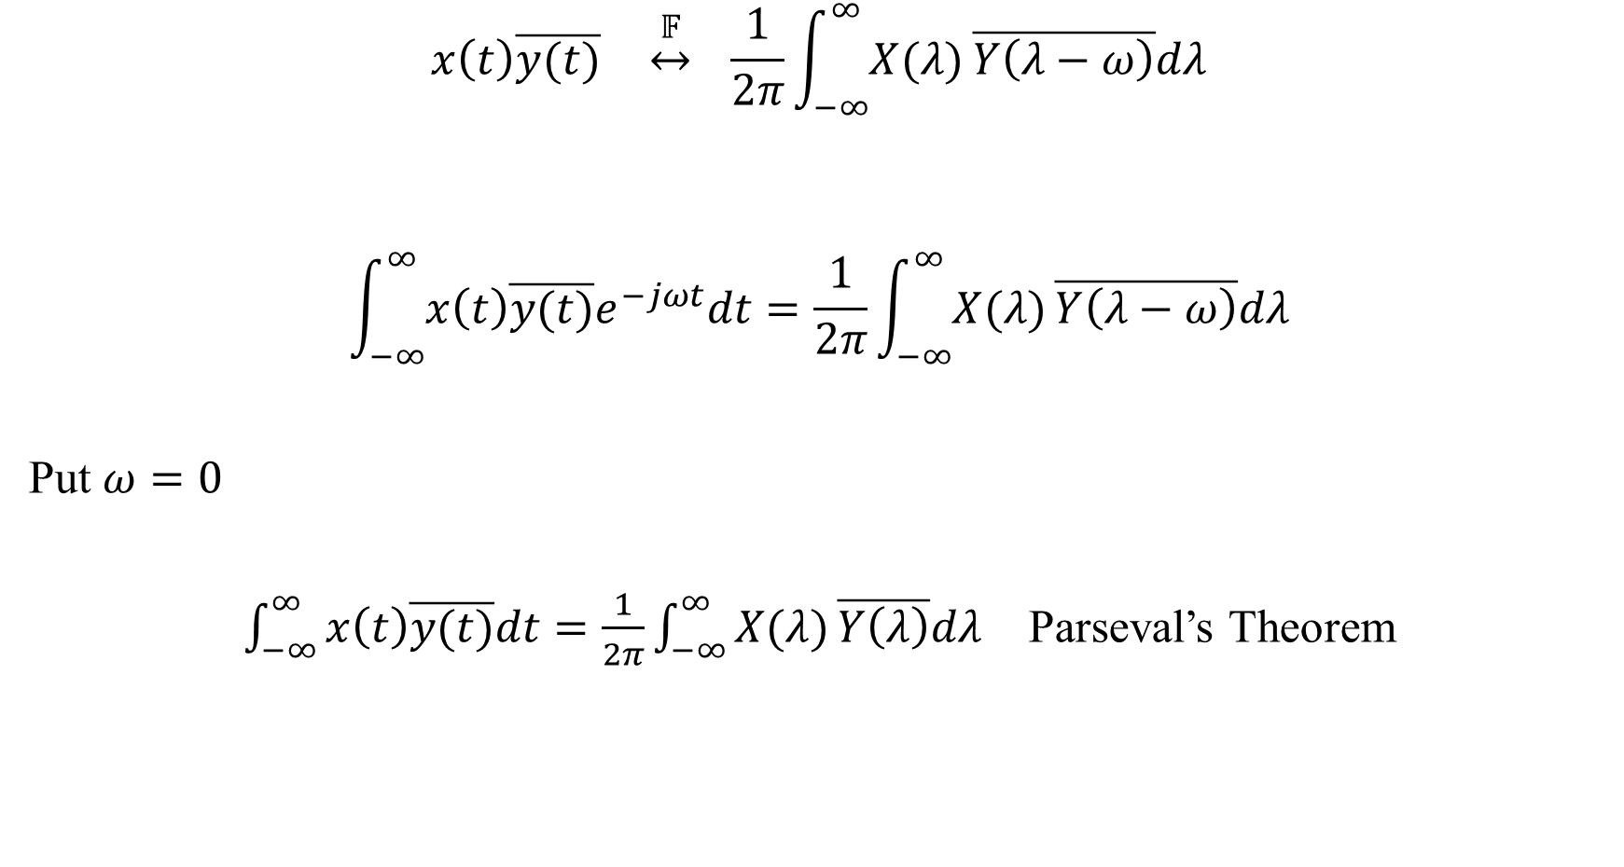
Parseval’s Theorem
$$x\left(t\right)\overline{y(t)} \underset{↔}{𝔽} \frac{1}{2π}\int_{−∞}^{∞}{X(λ)}\overline{Y\left(λ−ω\right)}dλ$$
$$\int_{−∞}^{∞}{x\left(t\right)\overline{y(t)}e^{−jωt}dt}=\frac{1}{2π}\int_{−∞}^{∞}{X(λ)}\overline{Y\left(λ−ω\right)}dλ$$
Put $ω=0$
$\int_{−∞}^{∞}{x\left(t\right)\overline{y(t)}dt}=\frac{1}{2π}\int_{−∞}^{∞}{X(λ)}\overline{Y\left(λ\right)}dλ$ Parseval’s Theorem

Slide 8
Parseval’s Theorem
Let $y\left(t\right)=x\left(t\right)$
$\int_{−∞}^{∞}{x\left(t\right)\overline{x(t)}dt}=\frac{1}{2π}\int_{−∞}^{∞}{X(λ)}\overline{X\left(λ\right)}dλ$
$\int_{−∞}^{∞}{{\left|x\left(t\right)\right|}^{2}dt}=\frac{1}{2π}\int_{−∞}^{∞}{{\left|X(ω)\right|}^{2}}dω$
${\left|X(ω)\right|}^{2}→$ Energy spectral density
${\left|x\left(t\right)\right|}^{2}→$ Energy time density.

Slide 9
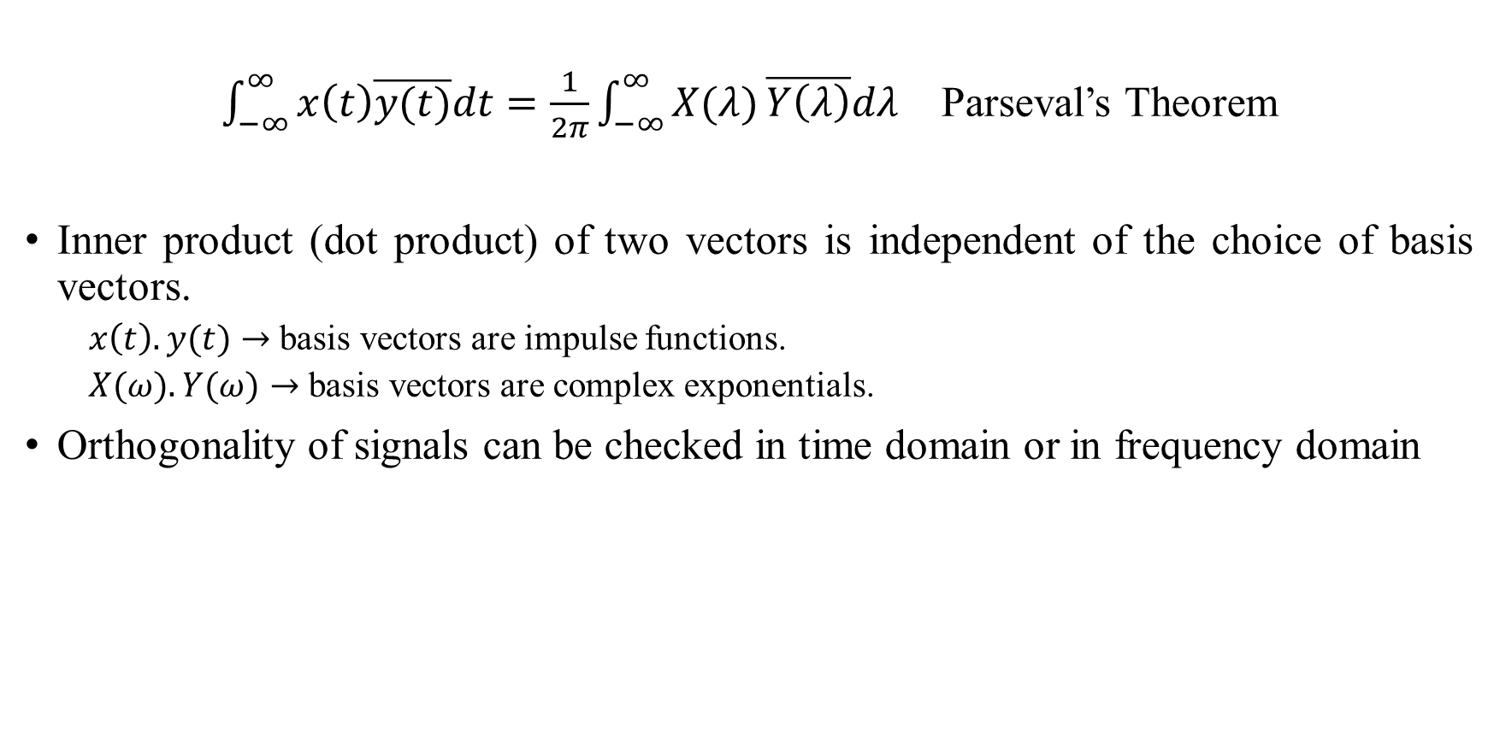
Parseval’s Theorem
$\int_{−∞}^{∞}{x\left(t\right)\overline{y(t)}dt}=\frac{1}{2π}\int_{−∞}^{∞}{X(λ)}\overline{Y\left(λ\right)}dλ$ Parseval’s Theorem
Inner product (dot product) of two vectors is independent of the choice of basis vectors.
  $x\left(t\right).y(t)→$ basis vectors are impulse functions.
  $X(ω).Y(ω)→$ basis vectors are complex exponentials.
Orthogonality of signals can be checked in time domain or in frequency domain

Slide 10

8. Differentiation
$$x\left(t\right)\underset{↔}{𝔽}X(ω)$$
$$\frac{dx(t)}{dt}\underset{↔}{𝔽}jωX(ω)$$

Slide 11
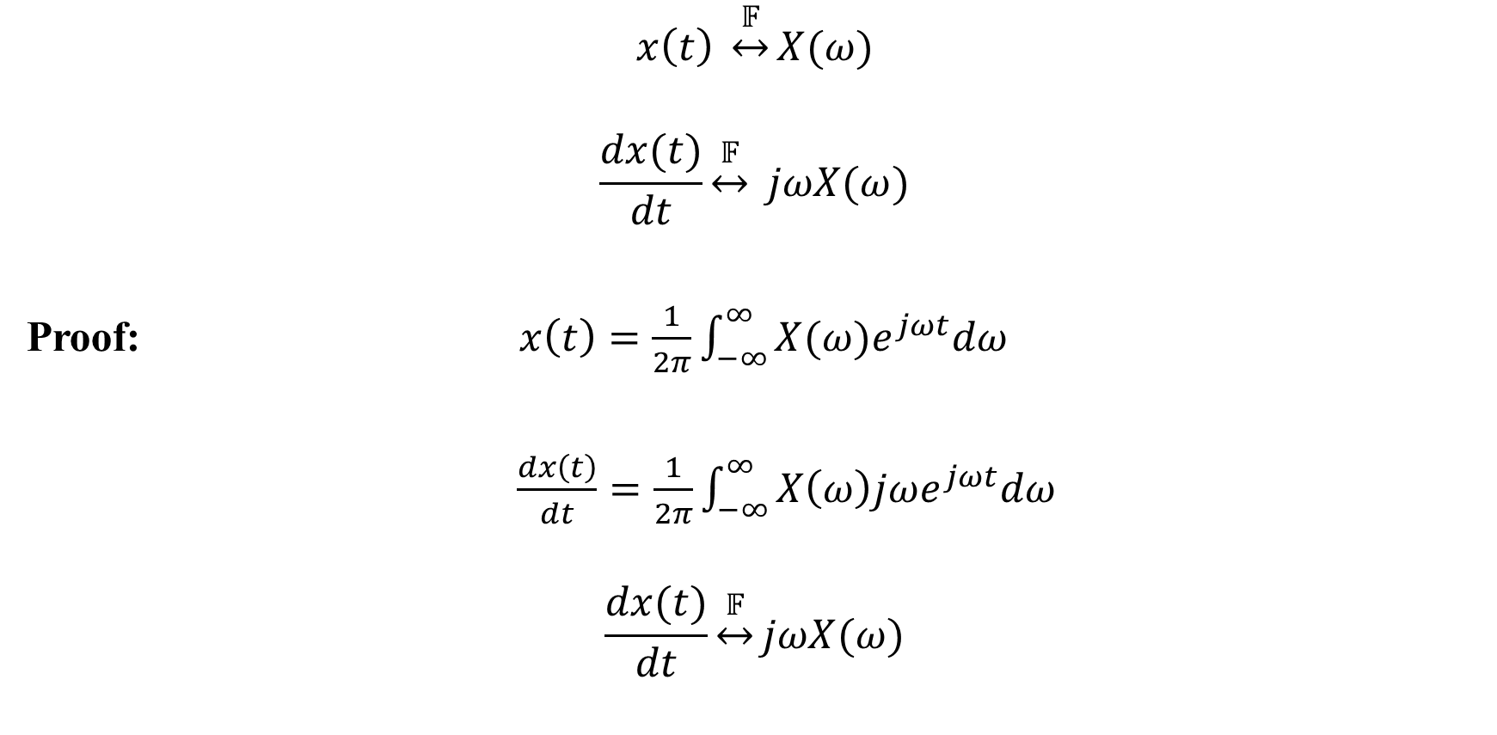
Differentiation
$$x\left(t\right) \underset{↔}{𝔽}X(ω)$$
$$\frac{dx(t)}{dt}\underset{↔}{𝔽} jωX(ω)$$
Proof: $x\left(t\right)=\frac{1}{2π}\int_{−∞}^{∞}{X(ω)e^{jωt}dω}$
$\frac{dx\left(t\right)}{dt}=\frac{1}{2π}\int_{−∞}^{∞}{X\left(ω\right)jωe^{jωt}dω}$
$$\frac{dx(t)}{dt}\underset{↔}{𝔽}jωX(ω)$$

Slide 12

Differentiation
Lower frequencies are present in DC (constant).
$$x^{′}(t)$$
$$x(t)$$
High frequencies
are present in edges.
$$Differentiation$$
$$\frac{T}{2}$$
$$t$$
$$t$$
$$−\frac{T}{2}$$
$$\frac{T}{2}$$
$$−\frac{T}{2}$$

Slide 13
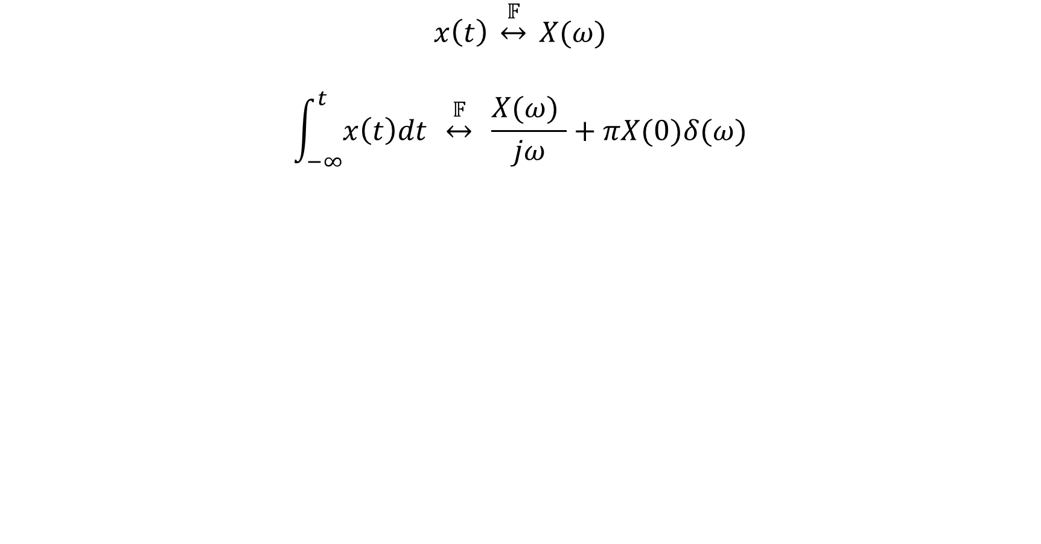
9. Integration
$$x\left(t\right) \underset{↔}{𝔽} X(ω)$$
$$\int_{−∞}^{t}{x\left(t\right)dt} \underset{↔}{𝔽} \frac{X(ω) }{jω}+πX(0)δ(ω)$$

Slide 14
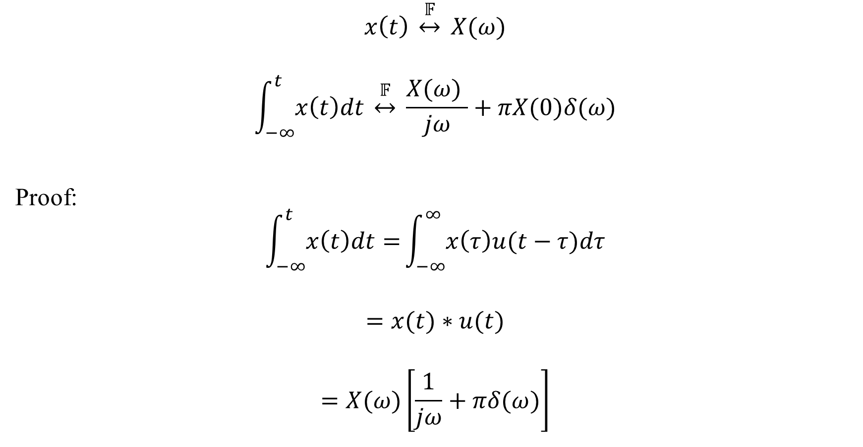
9. Integration
$$x\left(t\right) \underset{↔}{𝔽} X(ω)$$
$$\int_{−∞}^{t}{x\left(t\right)dt} \underset{↔}{𝔽} \frac{X(ω) }{jω}+πX(0)δ(ω)$$
Proof:
$$\int_{−∞}^{t}{x\left(t\right)dt=}\int_{−∞}^{∞}{x\left(τ\right)u(t−τ)dτ}$$
$$=x(t)∗u(t)$$
$$=X(ω)\left[\frac{1}{jω}+πδ(ω)\right]$$

Slide 15
Outline
Properties
Differential Equations

Slide 16
Differential equations
LTI and
Causal
A
p
$$\sum_{k=0}^{M}{a_{k}\frac{d^{k}y(t)}{dt^{k}}=\sum_{k=0}^{N}{b_{k}\frac{d^{k}x(t)}{dt^{k}}}}$$

Slide 17
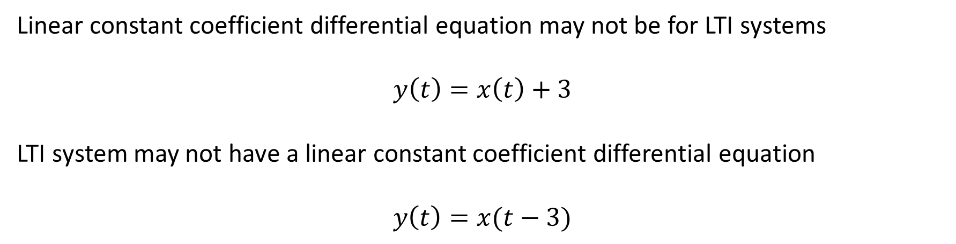
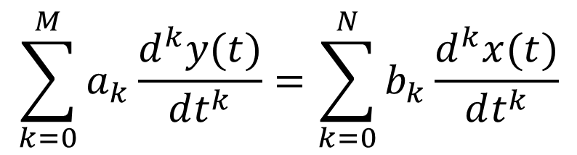
Differential equations
$$\sum_{k=0}^{M}{a_{k}\frac{d^{k}y(t)}{dt^{k}}=\sum_{k=0}^{N}{b_{k}\frac{d^{k}x(t)}{dt^{k}}}}$$
Linear constant coefficient differential equation may not be for LTI systems
$$y\left(t\right)=x\left(t\right)+3$$
LTI system may not have a linear constant coefficient differential equation
$$y\left(t\right)=x(t−3)$$

Slide 18
Differential equations
$$\sum_{k=0}^{M}{a_{k}\frac{d^{k}y(t)}{dt^{k}}=\sum_{k=0}^{N}{b_{k}\frac{d^{k}x(t)}{dt^{k}}}}$$
LTI system, causal and stable
$$\sum_{k=0}^{M}{a_{k}{\left(jω\right)}^{k}Y(ω) =\sum_{k=0}^{N}{b_{k}{\left(jω\right)}^{k}X(ω)}}$$
$$H\left(ω\right)=\frac{Y(ω)}{X(ω)}=\frac{\sum_{k=0}^{N}{b_{k}{\left(jω\right)}^{k}}}{\sum_{k=0}^{M}{a_{k}{\left(jω\right)}^{k}}}$$

Slide 19
Differential equations
LTI, causal, and stable
$$\frac{d^{2}y(t)}{dt^{2}}+5\frac{dy(t)}{dt}+6y\left(t\right)=\frac{dx(t)}{dt}+x\left(t\right)$$
$$H\left(ω\right)=\frac{Y(ω)}{X(ω)}=\frac{\sum_{k=0}^{N}{b_{k}{\left(jω\right)}^{k}}}{\sum_{k=0}^{M}{a_{k}{\left(jω\right)}^{k}}}$$
$$H\left(ω\right)=\frac{Y(ω)}{X(ω)}=\frac{}{}$$

Slide 20
Differential equations
LTI, causal, and stable
$$\frac{d^{2}y(t)}{dt^{2}}+5\frac{dy(t)}{dt}+6y\left(t\right)=\frac{dx(t)}{dt}+x\left(t\right)$$
$$H\left(ω\right)=\frac{Y(ω)}{X(ω)}=\frac{\sum_{k=0}^{N}{b_{k}{\left(jω\right)}^{k}}}{\sum_{k=0}^{M}{a_{k}{\left(jω\right)}^{k}}}$$
$$H\left(ω\right)=\frac{Y(ω)}{X(ω)}=\frac{}{}$$

Slide 21
Differential equations
LTI, causal, and stable
$$\frac{d^{2}y(t)}{dt^{2}}+5\frac{dy(t)}{dt}+6y\left(t\right)=\frac{dx(t)}{dt}+x\left(t\right)$$
$$H\left(ω\right)=\frac{Y(ω)}{X(ω)}=\frac{\sum_{k=0}^{N}{b_{k}{\left(jω\right)}^{k}}}{\sum_{k=0}^{M}{a_{k}{\left(jω\right)}^{k}}}$$
$$H\left(ω\right)=\frac{Y(ω)}{X(ω)}=\frac{1{\left(jω\right)}^{0}}{}$$

Slide 22
Differential equations
LTI, causal, and stable
$$\frac{d^{2}y(t)}{dt^{2}}+5\frac{dy(t)}{dt}+6y\left(t\right)=\frac{dx(t)}{dt}+x\left(t\right)$$
$$H\left(ω\right)=\frac{Y(ω)}{X(ω)}=\frac{\sum_{k=0}^{N}{b_{k}{\left(jω\right)}^{k}}}{\sum_{k=0}^{M}{a_{k}{\left(jω\right)}^{k}}}$$
$$H\left(ω\right)=\frac{Y(ω)}{X(ω)}=\frac{1{\left(jω\right)}^{0}+1{\left(jω\right)}^{1}}{}$$

Slide 23
Differential equations
LTI, causal, and stable
$$\frac{d^{2}y(t)}{dt^{2}}+5\frac{dy(t)}{dt}+6y\left(t\right)=\frac{dx(t)}{dt}+x\left(t\right)$$
$$H\left(ω\right)=\frac{Y(ω)}{X(ω)}=\frac{\sum_{k=0}^{N}{b_{k}{\left(jω\right)}^{k}}}{\sum_{k=0}^{M}{a_{k}{\left(jω\right)}^{k}}}$$
$$H\left(ω\right)=\frac{Y(ω)}{X(ω)}=\frac{1{\left(jω\right)}^{0}+1{\left(jω\right)}^{1}}{6{\left(jω\right)}^{0}}$$

Slide 24
Differential equations
LTI, causal, and stable
$$\frac{d^{2}y(t)}{dt^{2}}+5\frac{dy(t)}{dt}+6y\left(t\right)=\frac{dx(t)}{dt}+x\left(t\right)$$
$$H\left(ω\right)=\frac{Y(ω)}{X(ω)}=\frac{\sum_{k=0}^{N}{b_{k}{\left(jω\right)}^{k}}}{\sum_{k=0}^{M}{a_{k}{\left(jω\right)}^{k}}}$$
$$H\left(ω\right)=\frac{Y(ω)}{X(ω)}=\frac{1{\left(jω\right)}^{0}+1{\left(jω\right)}^{1}}{6{\left(jω\right)}^{0}+5{\left(jω\right)}^{1}}$$

Slide 25
Differential equations
LTI, causal, and stable
$$\frac{d^{2}y(t)}{dt^{2}}+5\frac{dy(t)}{dt}+6y\left(t\right)=\frac{dx(t)}{dt}+x\left(t\right)$$
$$H\left(ω\right)=\frac{Y(ω)}{X(ω)}=\frac{\sum_{k=0}^{N}{b_{k}{\left(jω\right)}^{k}}}{\sum_{k=0}^{M}{a_{k}{\left(jω\right)}^{k}}}$$
$$H\left(ω\right)=\frac{Y(ω)}{X(ω)}=\frac{1{\left(jω\right)}^{0}+1{\left(jω\right)}^{1}}{6{\left(jω\right)}^{0}+5{\left(jω\right)}^{1}+1{\left(jω\right)}^{2}}$$

Slide 26
Differential equations
LTI, causal, and stable
$$\frac{d^{2}y(t)}{dt^{2}}+5\frac{dy(t)}{dt}+6y\left(t\right)=\frac{dx(t)}{dt}+x\left(t\right)$$
$$H\left(ω\right)=\frac{Y(ω)}{X(ω)}=\frac{1{\left(jω\right)}^{0}+1{\left(jω\right)}^{1}}{6{\left(jω\right)}^{0}+5{\left(jω\right)}^{1}+1{\left(jω\right)}^{2}}$$

Slide 27
Differential equations
LTI, causal, and stable
$$\frac{d^{2}y(t)}{dt^{2}}+5\frac{dy(t)}{dt}+6y\left(t\right)=\frac{dx(t)}{dt}+x\left(t\right)$$
$$H\left(ω\right)=\frac{Y(ω)}{X(ω)}=\frac{1{\left(jω\right)}^{0}+1{\left(jω\right)}^{1}}{6{\left(jω\right)}^{0}+5{\left(jω\right)}^{1}+1{\left(jω\right)}^{2}}$$
$$=\frac{1+jω}{(2+jω)(3+jω)}$$
$$H\left(ω\right)=\frac{−1}{2+jω}+\frac{2}{3+jω}$$
h$\left(t\right)={−e}^{−2t}u\left(t\right)+2e^{−3t}u(t)$

Slide 28
Discrete-Time Signals and Systems

Slide 29
Why discrete systems ?
In Discrete systems, time is discrete (storage)
Discrete-time systems can be stored and processed digitally (using digital electronics)
Digital electronics is inexpensive !!
All modern systems are discrete-time systems

